Slide 1
Information Retrieval
Assignment 3
Presented by: M. Umair Shahid [2021-CS-144]
Instructor: Dr. Khaldoon Syed Khurshid
Department of Computer Science University of Engineering and Technology Lahore

Slide 2

Agenda
1.
Introduction
2.
Goal Definition
3.
Document Collection
4.
Implementation
5.
Models
6.
User Interface
7.
Comparative Analysis
8.
Performance Considerations
9.
Future Improvements

Slide 3

Introduction
Information Retrieval (IR) is about finding relevant documents
Three innovative retrieval approaches:
Probabilistic Model (Binary Independence Model)
Non-Overlapped List Model
Proximal Nodes Model

Slide 4

Goal Definition
What Are We Trying to Achieve?
Retrieve the most relevant documents based on a user's query.
Ensure efficiency and relevance using advanced computational methods.
Example:
Searching for "machine learning" in a library catalog.

Slide 5

Document Collection
Input: .txt files from a specified folder path.
Preprocessing:
Convert to lowercase.
Extract nouns using a heuristic function optimized for terms.
Example of extracted terms: "automation, robotics, AI, ethics".

Slide 6
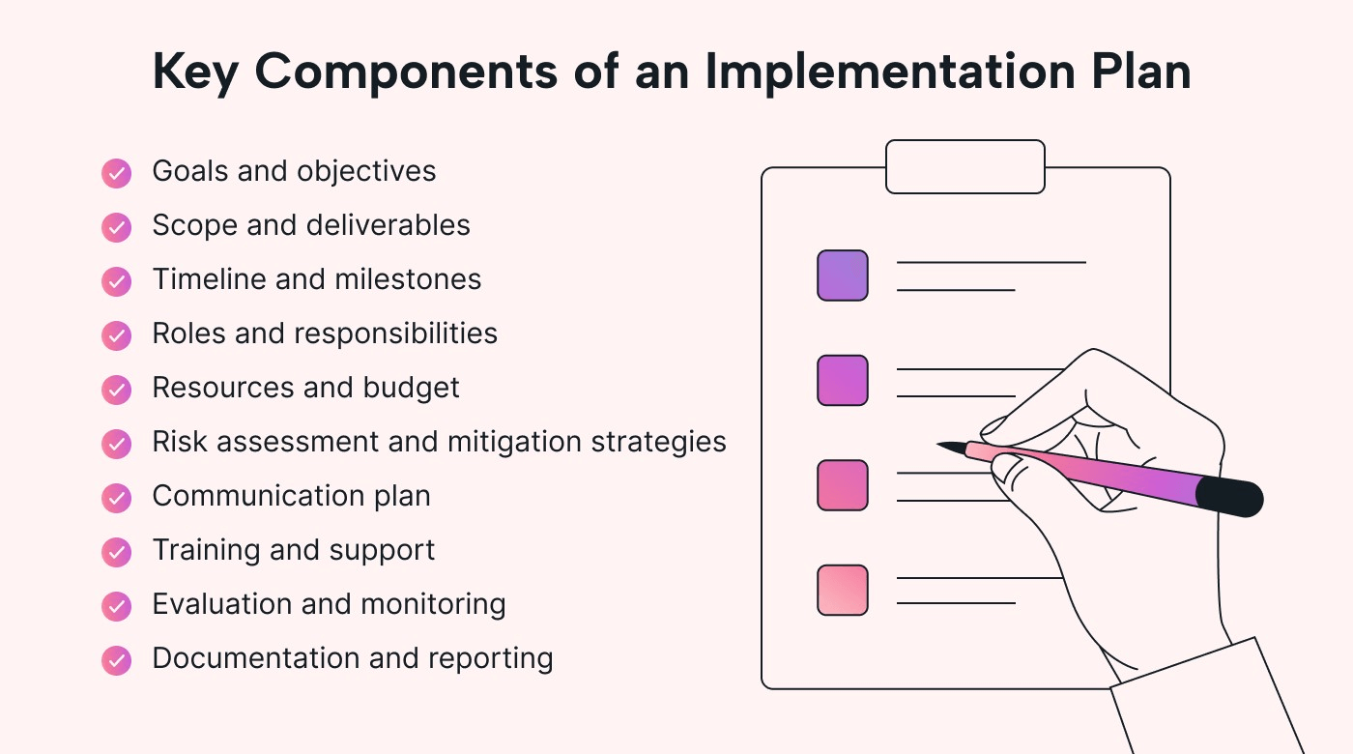
Implementation
Technical Foundations:
Python-based implementation
Libraries used:
Os for file handling
Colorama for colorful terminal output
Custom graph and linked list implementations
Common Tools:
Noun extraction algorithms
Flexible search mechanisms
Interactive user interfaces

Slide 7
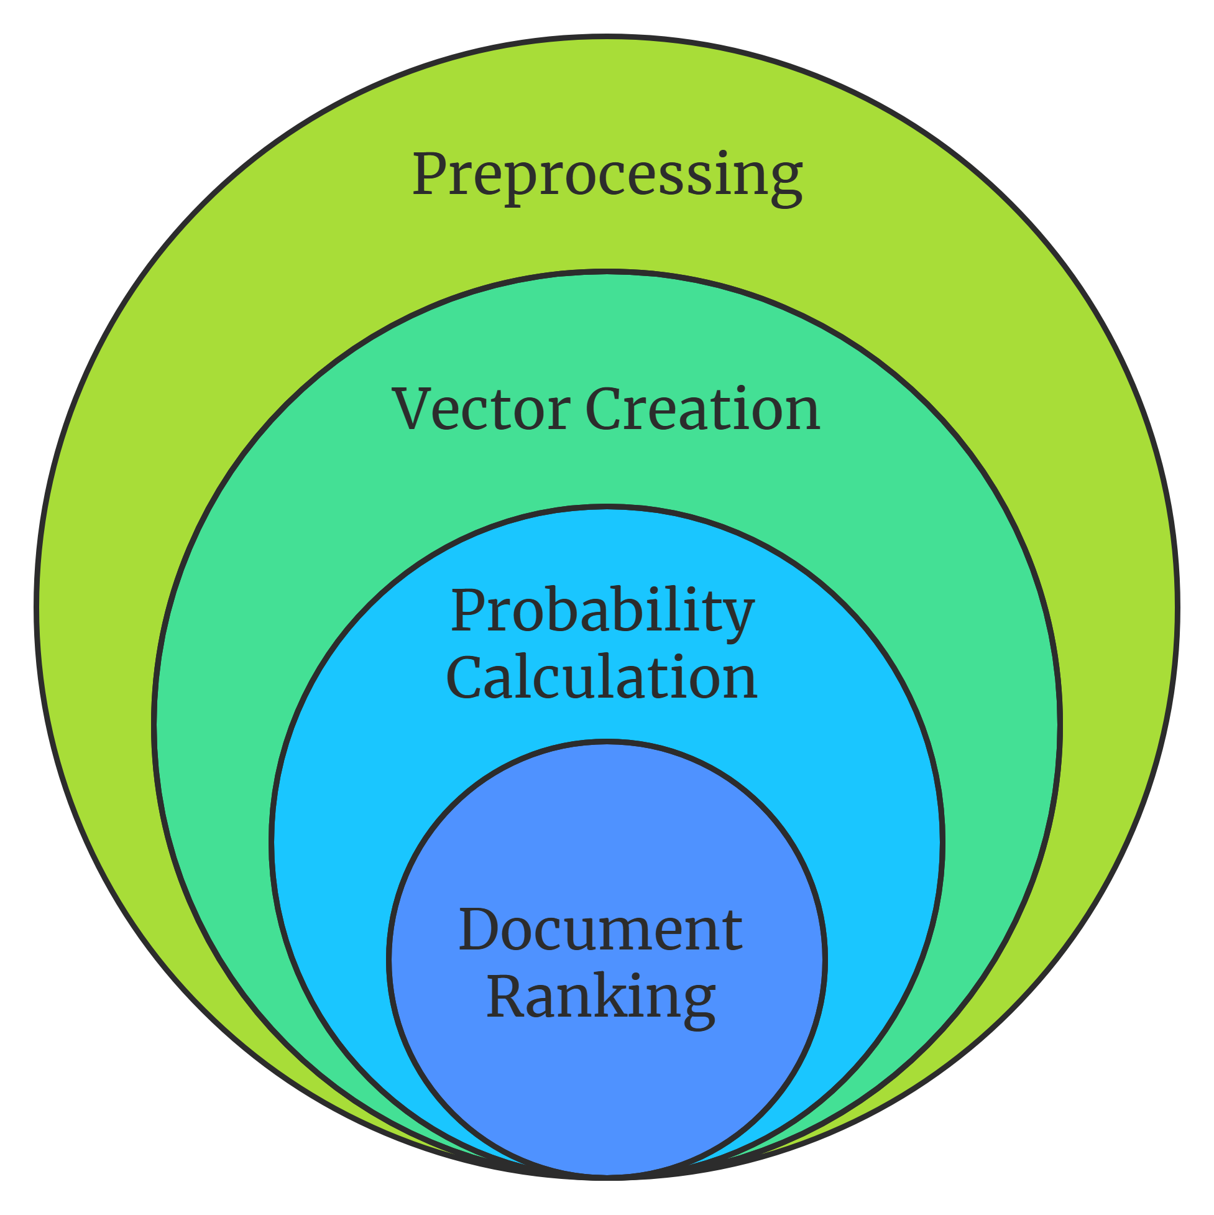
Probabilistic Model (BIM)
Key Characteristics:
Uses binary representation of terms
Scoring based on term presence/absence
Calculates document relevance using Dice Coefficient
Process:
Preprocess documents
Create binary term vectors
Calculate term probabilities
Rank documents based on query matching
Example:
Query: " Technology“
Documents scored on how many query terms they contain

Slide 8
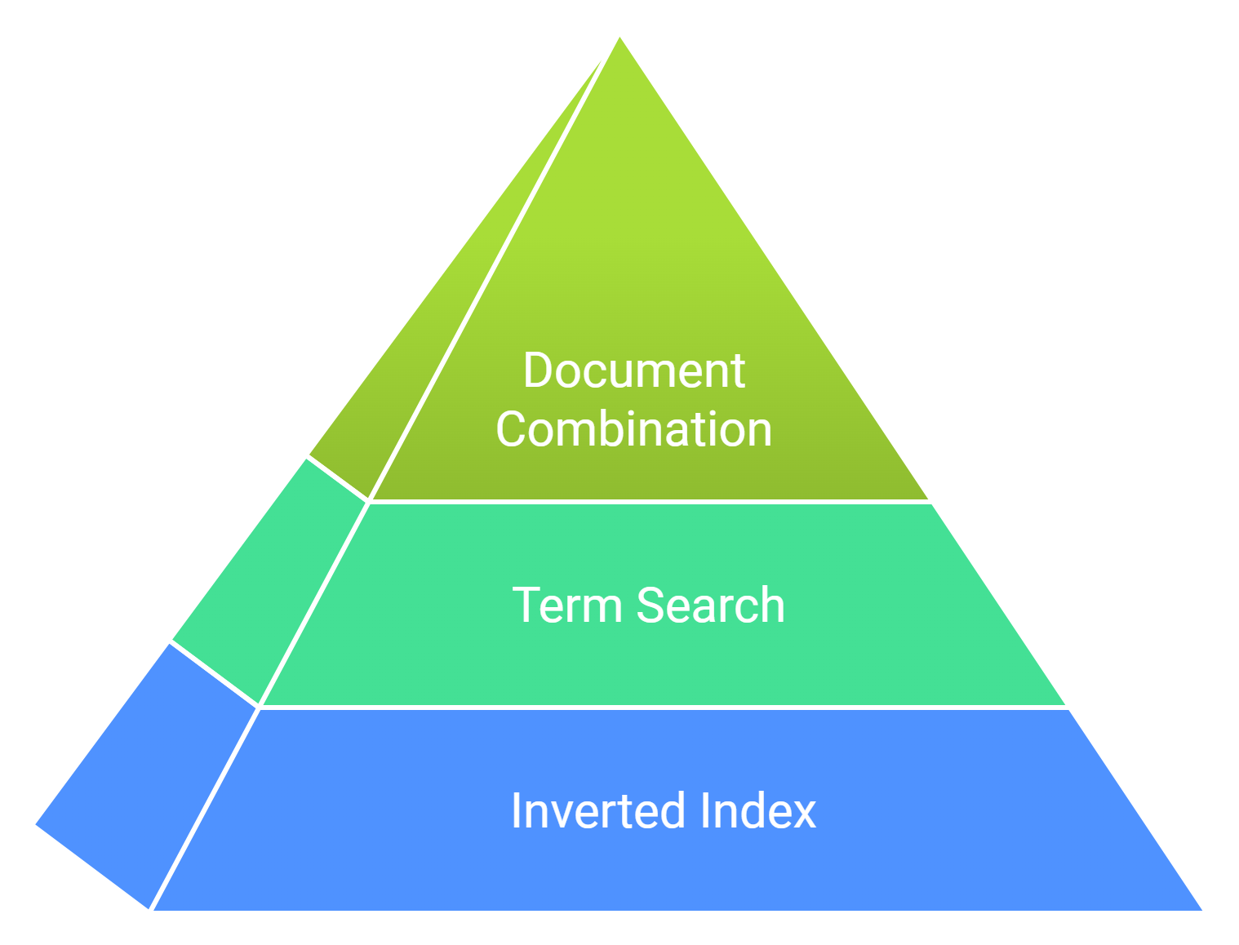
Non-Overlapped List Model
Unique Approach:
Retrieves documents based on multiple search terms
Creates a union of document lists
Ensures no duplicate document entries
Process:
Build inverted index of nouns
Search for multiple terms
Combine document lists without repetition
Visualization:
Search for "AI" and " Technology “
Returns unique documents containing either term

Slide 9
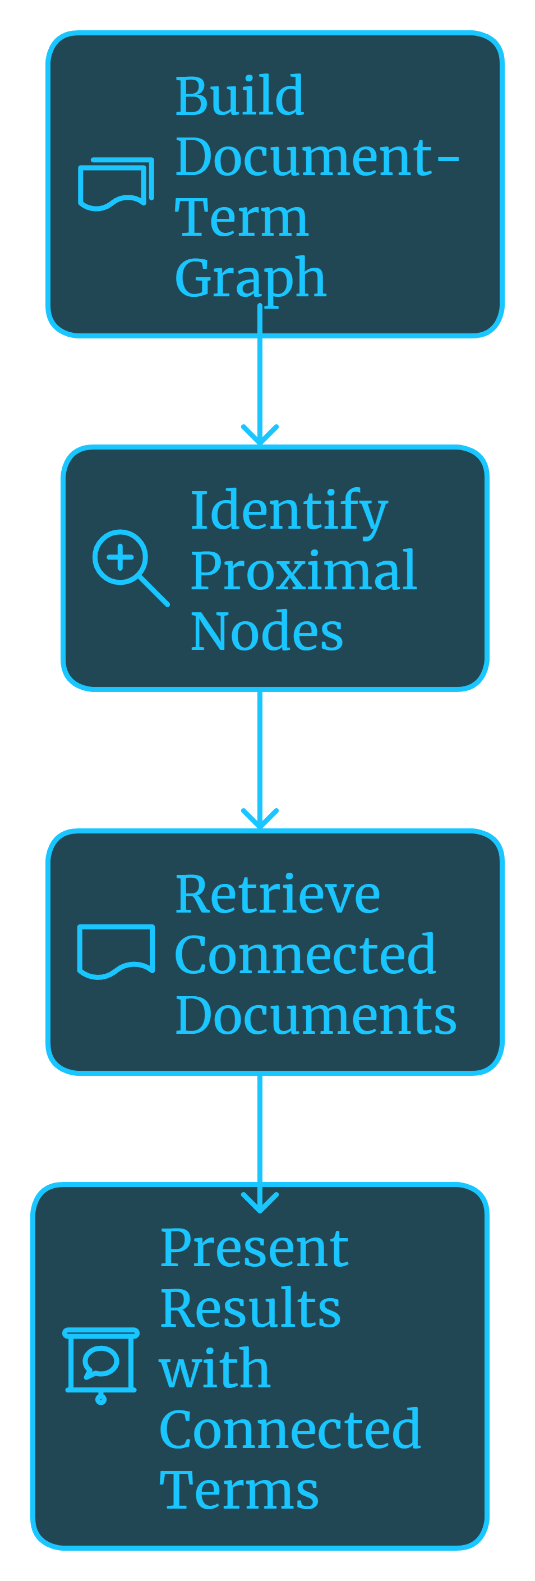
Proximal Nodes Model
Graph-Based Retrieval:
Represents documents and terms as a network
Finds connected nodes (documents and terms)
Uses graph traversal to identify relevant documents
Process:
Build a document-term graph
Identify proximal (nearby) nodes
Retrieve connected documents
Present results with connected terms
Example:
Query: " AI ethics in automation“
Finds documents connected to “AI", “automation"

Slide 10

User Interface
Interactive Features:
Directory selection
Multiple search options
Detailed result presentation
Error handling and user guidance
User Experience:
Colored terminal output
Descriptive error messages
Multiple search attempts allowed

Slide 11

Comparative Analysis
Model Differences
Probabilistic Model:
Statistical matching
Best for precise term matching
Non-Overlapped List:
Comprehensive term coverage
Ideal for broad searches
Proximal Nodes:
Network-based retrieval
Great for exploring related concepts

Slide 12

Performance Considerations
Strengths:
Flexible document retrieval
Advanced term recognition
Multiple search strategies
Limitations:
Dependent on quality of noun extraction
Performance varies with document collection

Slide 13

Future Improvements
Potential Enhancements
Machine learning integration
More sophisticated noun extraction
Advanced graph traversal algorithms
Support for larger document collections
Research Directions
Improved relevance ranking
Semantic understanding
Multilingual support

Slide 14
Thank You
Suggestions and Questions are welcomed!

